Slide 1

Deep Learning Image Classification Using Convolutional Neural Networks (CNN)
Presented by- GAURI VINOD CHAUDHARI
Intern id- MST03-0072
Guided by-urooj khan

Slide 2
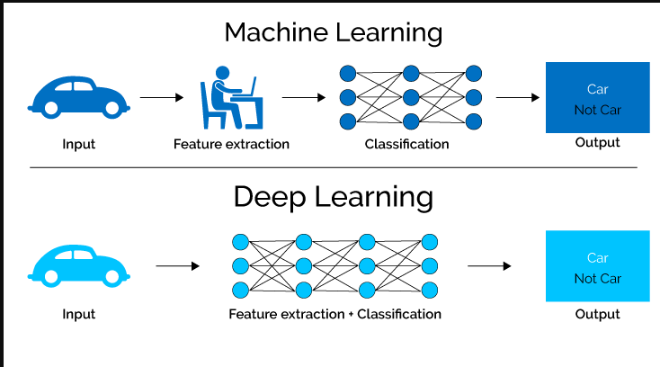
What is Deep Learning ?
Deep learning is a subset of machine learning, which itself is a branch of artificial intelligence (AI).
Deep learning models are inspired by the structure and function of the human brain, specifically the neural networks.
These models are capable of learning from vast amounts of data, identifying patterns, and making decisions with minimal human intervention.

Slide 3
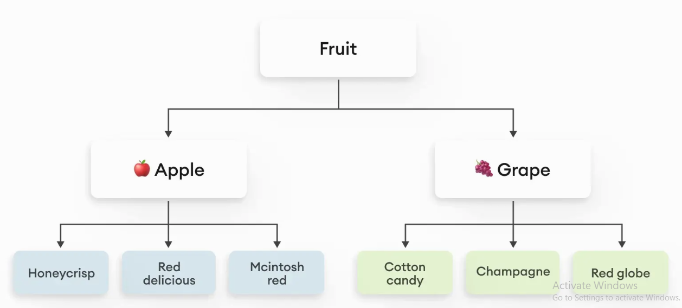
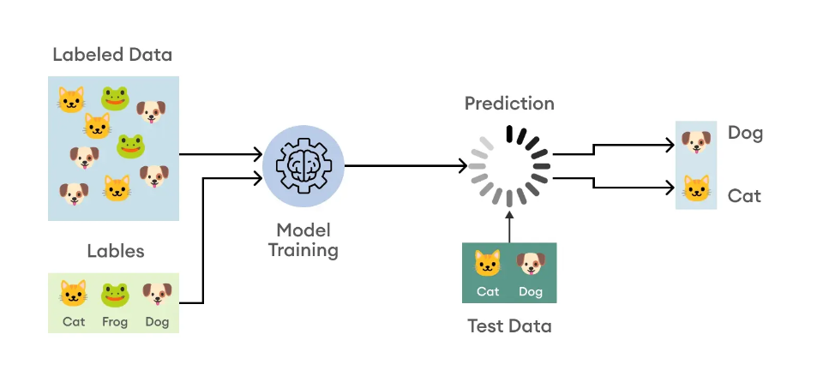
What is image classification?
Image classification refers to a process in computer vision that can classify an image according to its visual content.
For example, an image classification algorithm may be designed to tell if an image contains a human figure or not.

Slide 4

Data Collection:
Size: Large datasets help models learn intricate patterns and reduce overfitting.
High-quality data is crucial for training deep learning models. The performance of a deep learning model is heavily dependent on the quantity and quality of the data used for training.
Diversity: Models need diverse data to generalize well to various scenarios.
Size : Large datasets help models learn intricate patterns and reduce overfitting.
Eg : cifar10 , Kaggle

Slide 5
Data Preparation for Deep Learning:
import tensorflow as tf
from tensorflow.keras import layers, models
import numpy as np
import matplotlib.pyplot as plt
from tensorflow.keras.datasets import cifar10
# Load the dataset (train_images, train_labels), (test_images, test_labels) = cifar10.load_data()
# Normalize the pixel values to be between 0 and 1 train_images, test_images = train_images / 255.0, test_images / 255.0
# Define the class names class_names = ['airplane', 'automobile', 'bird', 'cat', 'deer', 'dog', 'frog', 'horse', 'ship', 'truck']

Slide 6
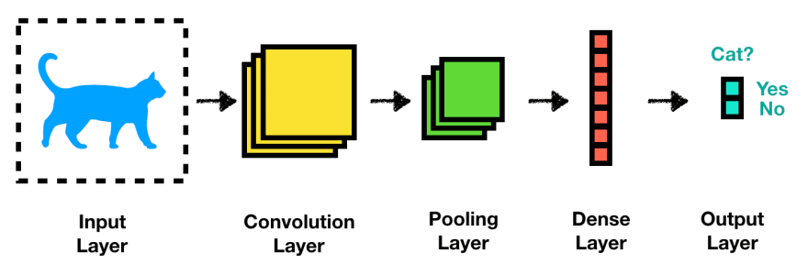
Convolutional Neural Network (CNN)
A (CNN) is a type of deep learning algorithm that is particularly well-suited for image recognition and processing tasks.
It is made up of multiple layers, including convolutional layers, pooling layers, and fully connected layers.
The architecture of CNNs is inspired by the visual processing in the human brain, and they are well-suited for capturing hierarchical patterns and spatial dependencies within images.

Slide 7
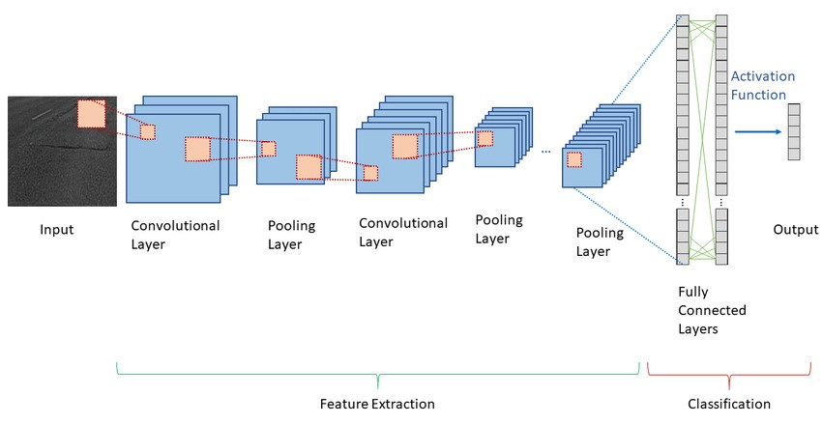
CNN Architecture:
A common CNN architecture have six layers that is:
Input Layer: Takes the raw pixel values of the image.
Convolutional Layer + ReLU: Extracts features from the image.
Pooling Layer: Reduces the dimensionality of the feature maps.
Convolutional Layer + ReLU: Further extracts features from the image.
Pooling Layer: Further reduces the dimensionality.
Fully Connected Layer: Combines features to make a decision.
Output Layer: Produces the final classification.

Slide 8
CNN Model Architecture:
from tensorflow.keras import layers, models
model = models.Sequential()
model.add(layers.Conv2D(32, (3, 3), activation='relu', input_shape=(32, 32, 3)))
model.add(layers.MaxPooling2D((2, 2)))
model.add(layers.Conv2D(64, (3, 3), activation='relu'))
model.add(layers.MaxPooling2D((2, 2)))
model.add(layers.Conv2D(64, (3, 3), activation='relu'))
model.add(layers.Flatten())
model.add(layers.Dense(64, activation='relu'))
model.add(layers.Dense(10))

Slide 9
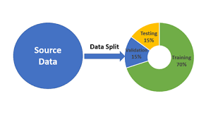
Data splitting:
Data splitting is a crucial step in the machine learning workflow. Typically, the dataset is split into three parts: the training set, the validation set, and the test set.
Training Set : The model learns from this data, adjusting its parameters to minimize the loss function.
Validation Set : It helps in model selection and tuning, providing a checkpoint to see how well the model is generalizing to unseen data during training.
Test Set : It provides an unbiased evaluation of the model’s performance on completely unseen data after the model is trained and tuned.

Slide 10
CONCLUSION :
In conclusion, this project successfully demonstrates the implementation of an image classification system using CNNs and the CIFAR-10 dataset.
The system shows promising results in accurately recognizing various objects in images, with potential applications in areas such as autonomous driving and object detection.by the help of CNN
Future work may involve further optimization of the model architecture and exploring additional datasets and deployment options for wider accessibility.

Slide 11
THANK YOU

